Slide 1
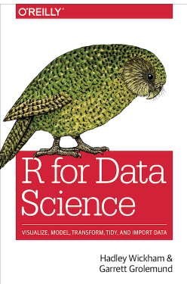
Chapters 4 and 8 Project Workflow Follow along here: https://r4ds.had.co.nz/workflow-scripts.html https://r4ds.had.co.nz/workflow-projects.html
Source:https://r4ds.had.co.nz/

Slide 2
Rstudio Panes
Source Editor
type code
can save as scripts
as .R text files
Environment/History
view objects
view command history
Console
code is evaluated here
Files
Plots
Packages
Help

Slide 3
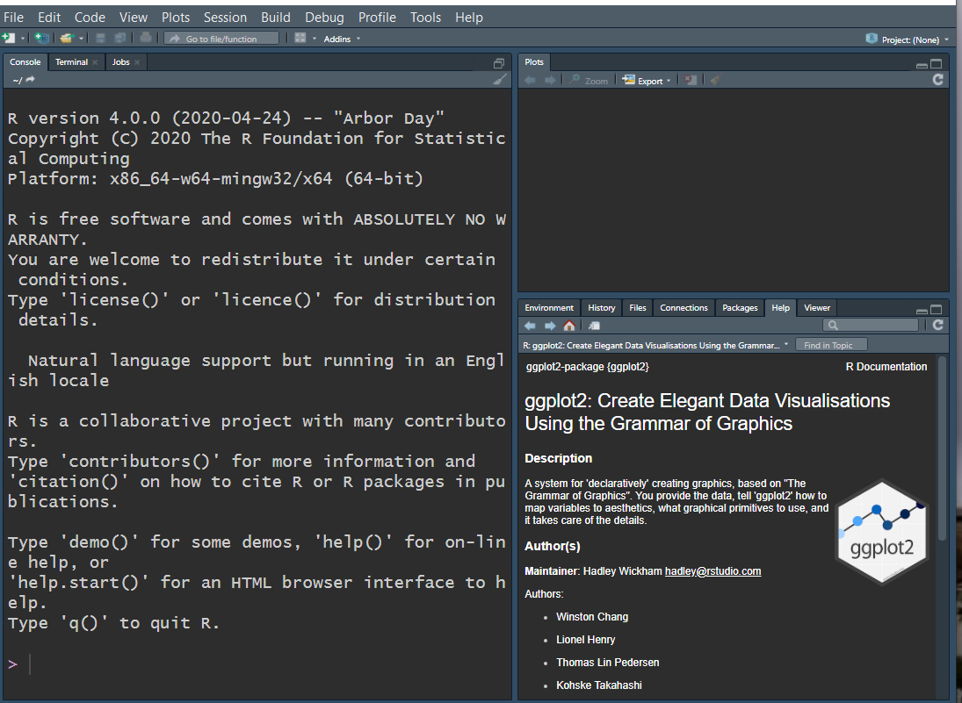
6.0 – 6.2 Workflow Scripts
Getting outside of the Console…

Slide 4
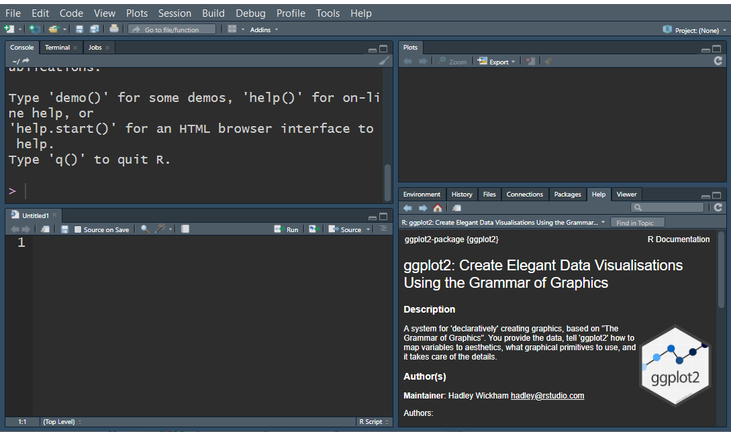
6.0 – 6.2 Workflow Scripts
Get into the habit of using the Scripts Editor.
The script editor is a great place to put code you care about.
Use the console for experimentation.
Once you have written code that works and does what you want, put it in the script editor. Cmd/Ctrl + Shift + N
RStudio will automatically save the contents of the editor when you quit RStudio, and will automatically load it when you re-open. Save your scripts regularly, and back them up.

Slide 5
6.0 – 6.2 Workflow Scripts
The script editor is also a great place to build up complex ggplot2 plots or long sequences of dplyr manipulations.
Cmd/Ctrl + Enter executes the current R expression in the console.
Instead of running expression-by-expression, you can also execute the complete script in one step: Cmd/Ctrl + Shift + S. Doing this regularly is a great way to check that you’ve captured all the important parts of your code in the script.

Slide 6
8.0 – 8.4 Workflow Projects
What about your analysis is “real”, i.e. what will you save as your lasting record of what happened?
Where does your analysis “live”?
It’s helpful to start to consider the scripts themselves as real, and the environments as reproducible.
It’s tragic to lose a script, but you can always recreate an environment.

Slide 7
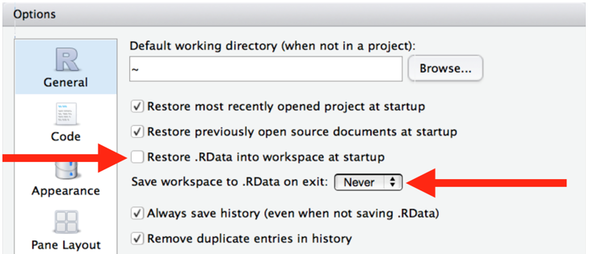
8.0 – 8.4 Workflow Projects
Begin to foster the behavior of NOT saving your environment between sessions. The purpose of this is to develop the habit of capturing all important interactions in your code.

Slide 8
8.0 – 8.4 Workflow Projects
Press Cmd/Ctrl + Shift + F10 to restart RStudio.
Press Cmd/Ctrl + Shift + S to rerun the current script.

Slide 9
8.0 – 8.4 Workflow Projects
As a beginning R user, it’s OK to let your home directory, documents directory, or any other weird directory on your computer be R’s working directory.
But now, we’re going to start to think in terms of placing projects into their own directories and, when working on a project, setting R’s working directory to the associated directory.

Slide 10
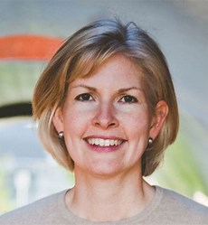
8.0 – 8.4 Workflow Projects
Workflow v. Product:
Workflow:
The editor you use to write your R code
The name of your home directory
The R code you run before launch
Product:
The raw data
The R code someone needs to run your raw data to get your results including the explicit library calls to load necessary packages. https://www.tidyverse.org/blog/2017/12/workflow-vs-script/ https://jennybryan.org

Slide 11
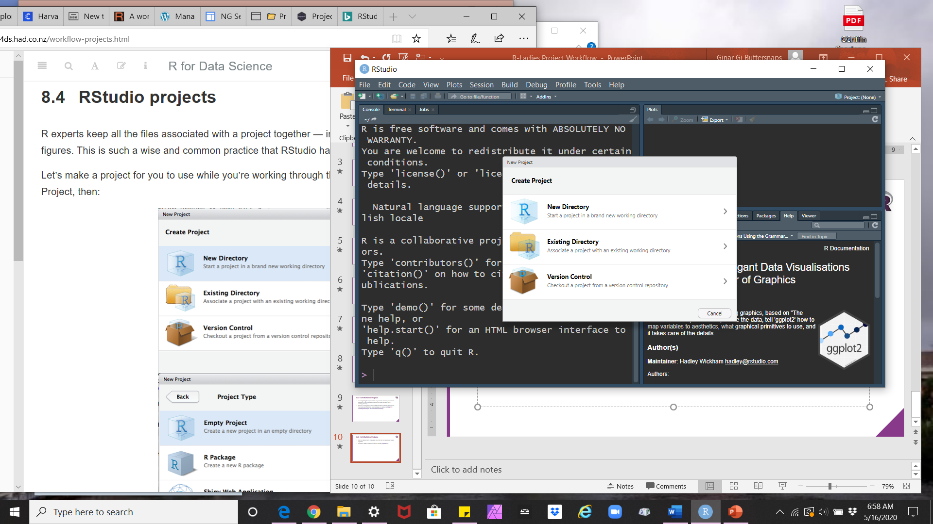
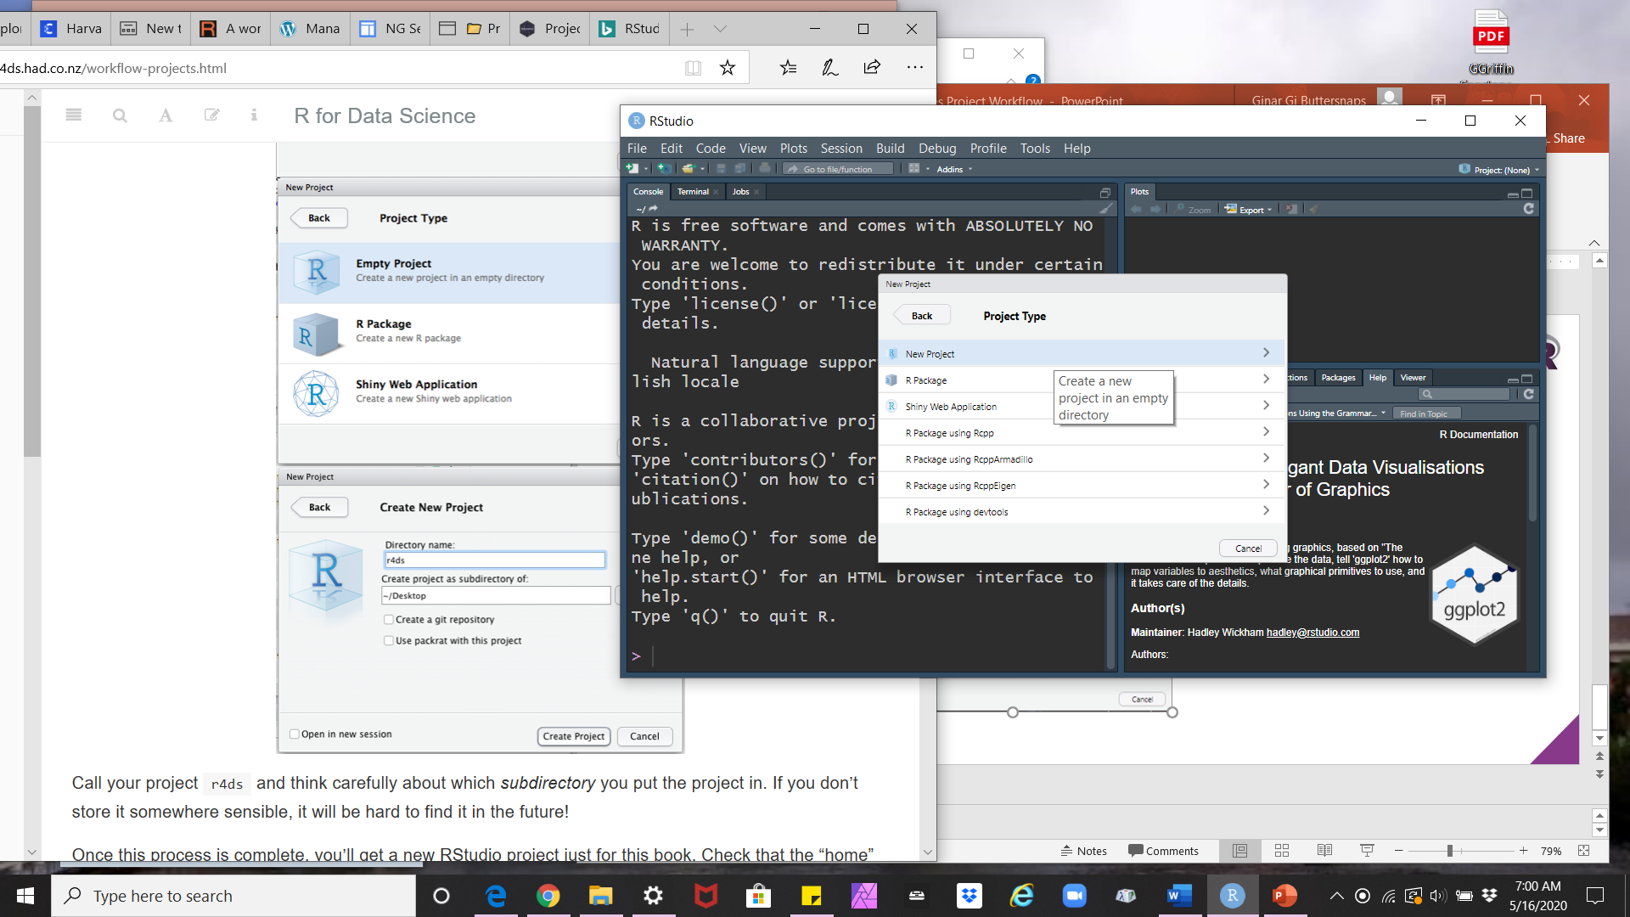
8.0 – 8.4 Workflow Projects
Start to think in terms of keeping all of the files for a particular project together.
R Studio’s built-in support for this is creating Project files.

Slide 12
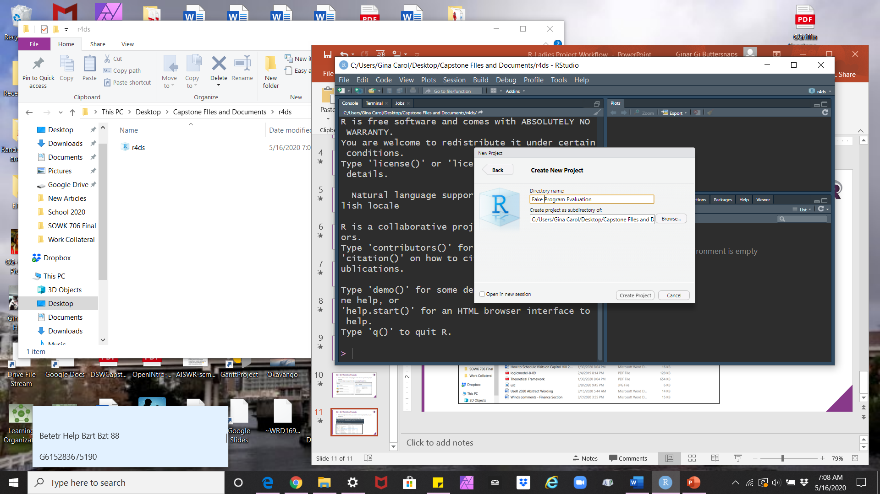
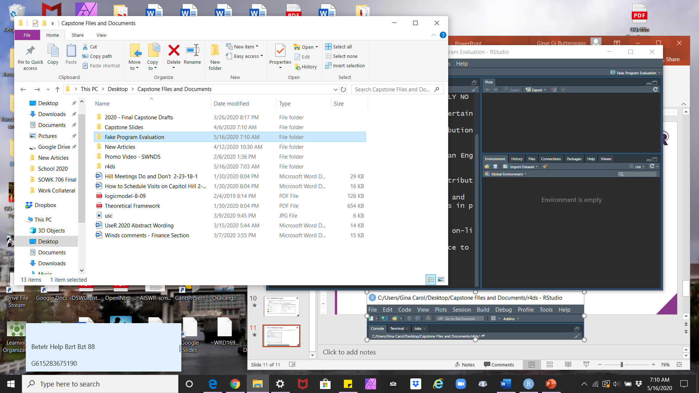
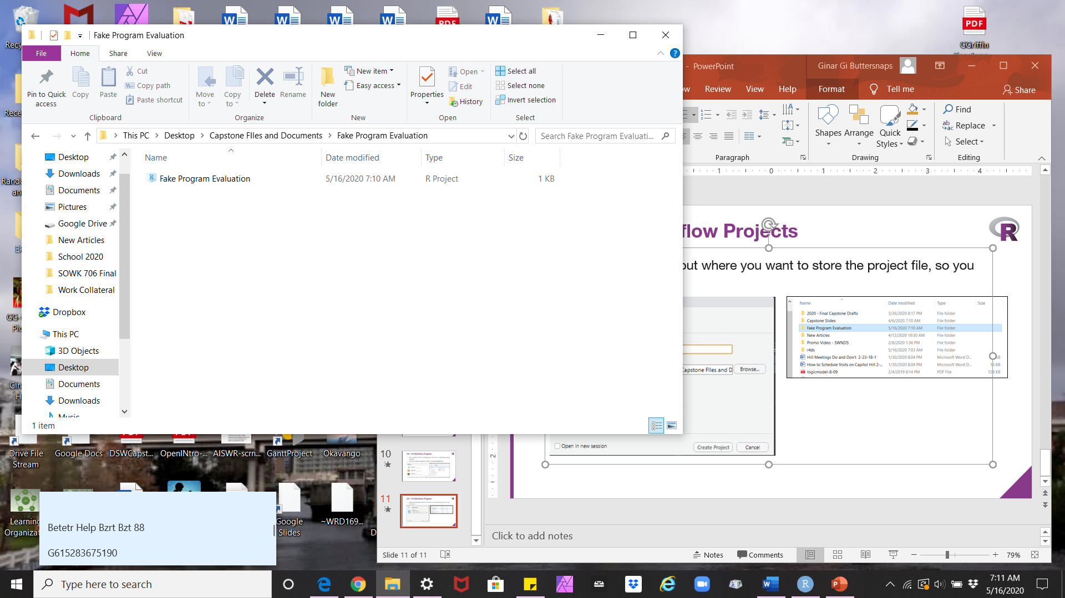
8.0 – 8.4 Workflow Projects
Think carefully about where you want to store the project file, so you can find it.

Slide 13
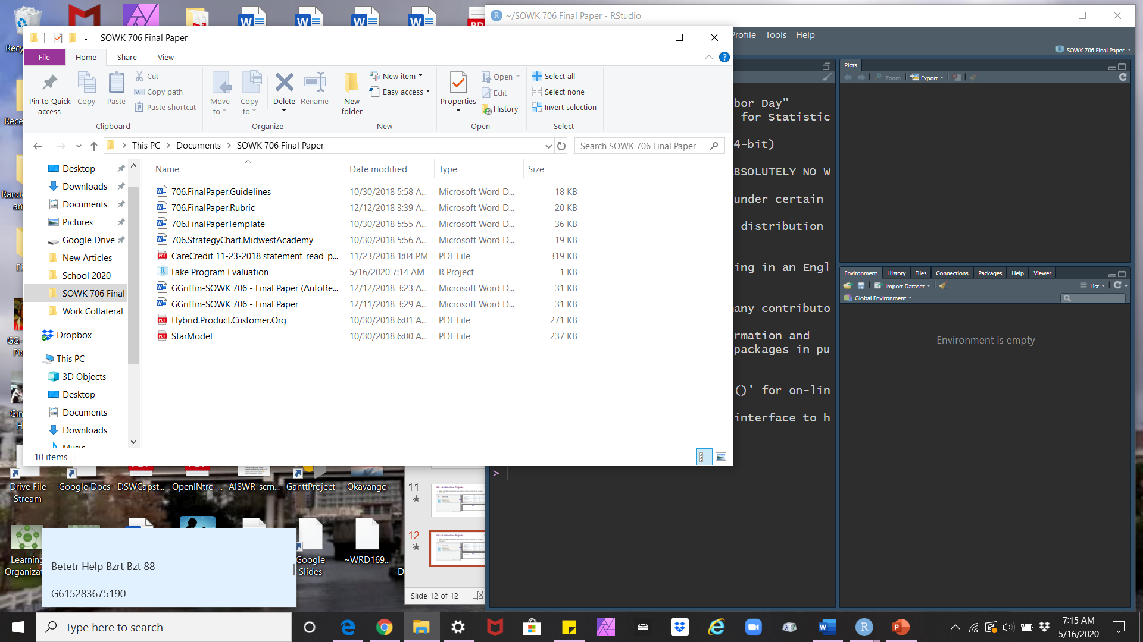
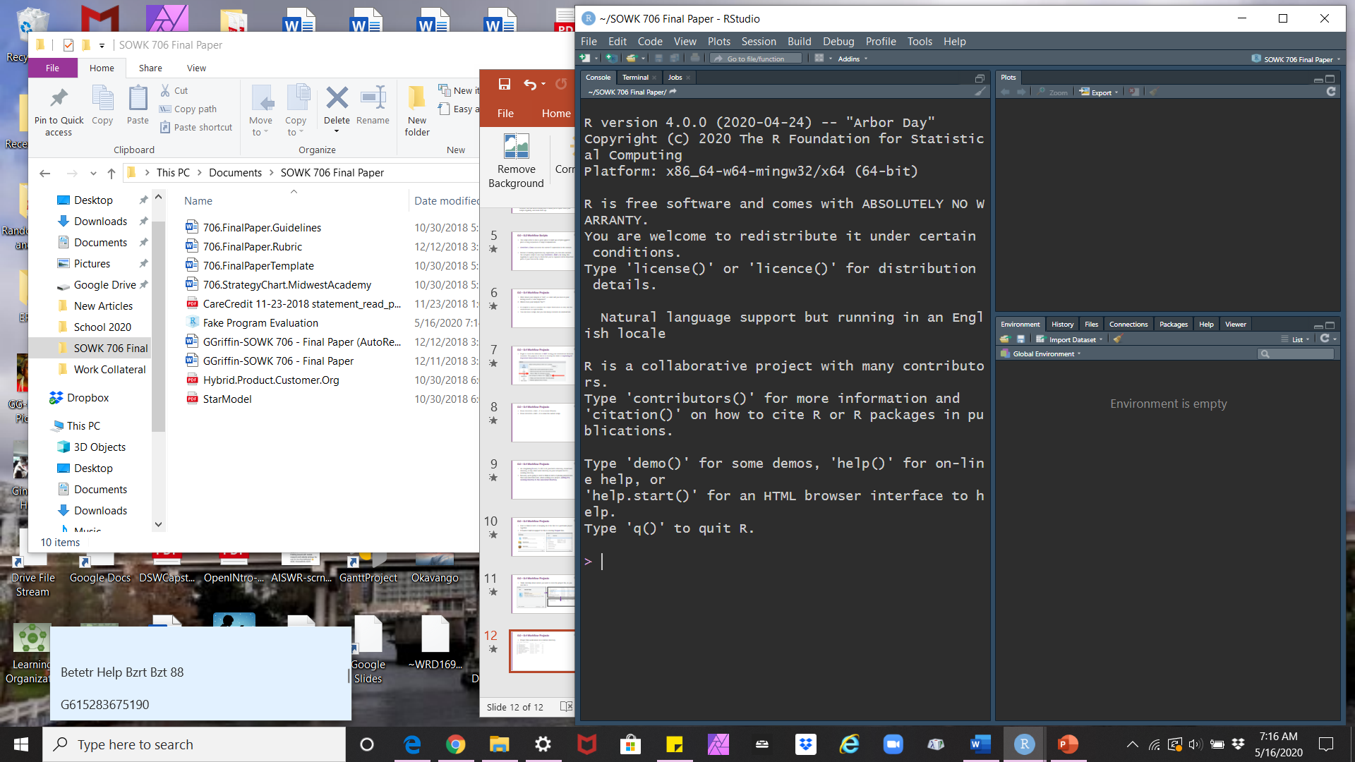
8.0 – 8.4 Workflow Projects
Project files work based on a relative directory.

Slide 14
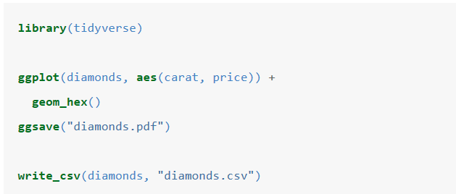
8.0 – 8.4 Workflow Projects
Open project, and create this script…

Slide 15
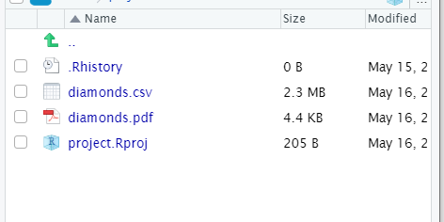
8.0 – 8.4 Workflow Projects
Quit R Studio, and look at your Project folder.

Slide 16
8.0 – 8.4 Workflow Projects
In summary, RStudio projects give you a solid workflow that will serve you well in the future:
Create an RStudio project for each data analysis project.
Keep data files there; we’ll talk about loading them into R in data import.
Keep scripts there; edit them, run them in bits or as a whole.
Save your outputs (plots and cleaned data) there.
Only ever use relative paths, not absolute paths.
Everything you need is in one place, and cleanly separated from all the other projects that you are working on.

Slide 17
8.0 – 8.4 Workflow Projects
What not to do…
Never include install.packages() or setwd() in a script that you share. It’s very antisocial to change settings on someone else’s computer!

Slide 18
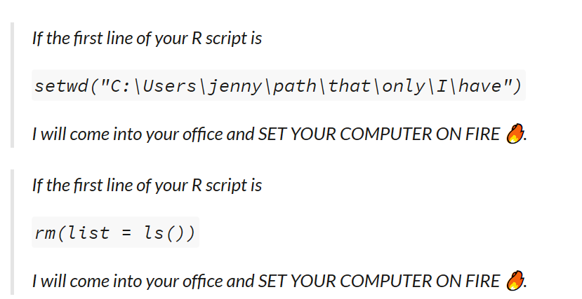
8.0 – 8.4 Workflow Projects
What not to do… https://www.tidyverse.org/blog/2017/12/workflow-vs-script/

Slide 19
8.0 – 8.4 Workflow Projects
What not to do…
Setwd() : Clearly, will attempt to point the new user to a file path that will only work on the computer of the person who created it.

Slide 20
8.0 – 8.4 Workflow Projects
What not to do… rm(list = ls()) :
Does NOT, in fact, create a fresh R process. All it does is delete user-created objects from the global workspace.
You might write paths relative to some random working directory, then be puzzled next month when nothing can be found or results don’t appear where you expect.
You might code up an analysis assuming that stringsAsFactors = FALSE but next week, when you have restarted R, everything will inexplicably be broken.
You might use functions from a package without including the necessary library() call. Your collaborator won’t be able to run this script.

Slide 21
8.0 – 8.4 Workflow Projects
What not to do…
The solution is to write every script assuming it will be run in a fresh R process.

Slide 22
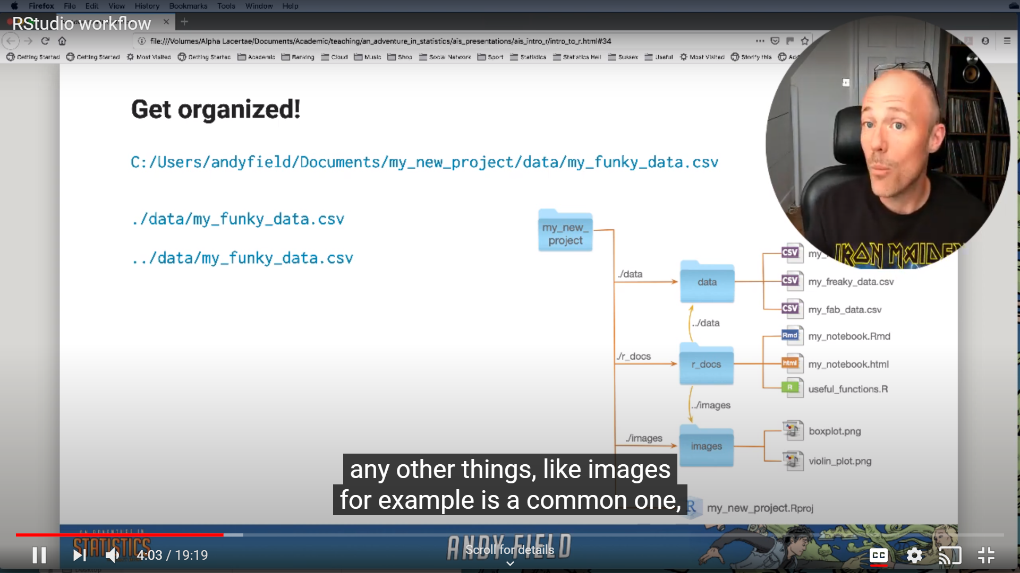
Andy Field
RStudio Workflow: https://www.youtube.com/watch?v=A52Q50sIQ-I&t=25s
YouTube Channel: https://www.youtube.com/channel/UCakigkjm3vBzEHpFzECDXQQ

Slide 23
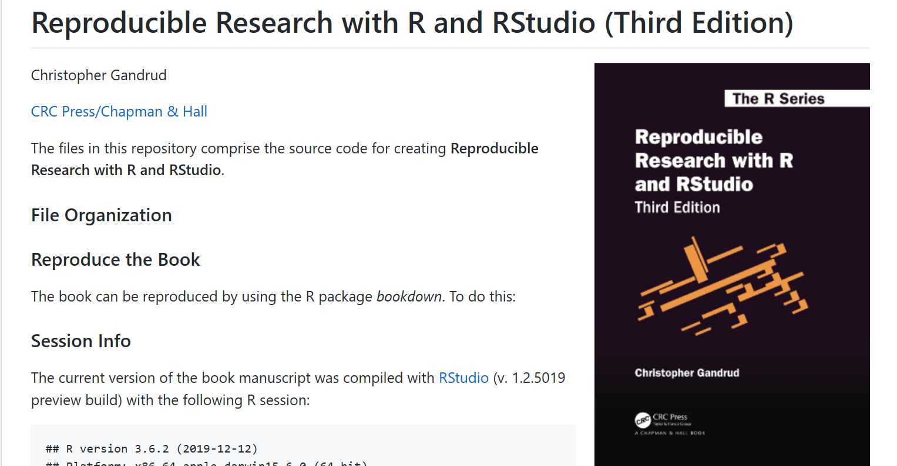
Christopher Gandrud
https://github.com/christophergandrud/Rep-Res-Book

